Slide 1

Case Study
Improving the Success metrics – BIG Numbers!

Slide 2

Tech Requirements
JRE/Eclipse/Maven
Rest-API(Jersey)
Log4J,Quartz
Twitter open source library

Slide 3

Introduction
The platform we work on, helps consumers live better financial lives through innovative products and services created for more than 1,200 financial institutions and FinTech companies, including 15 of the top 20 U.S. banks.
Below are some of the solution the platform/product provides.
Data Aggregation
Account Verification
Transaction Data Enrichment, Financial Wellness , Assets

Slide 4


Some Background…
Our product provides solution for – Data Aggregation, Account Verification, Transaction Data Enrichment, Financial Wellness, Assets etc.
To achieve this we need to get the data on behalf of user from the accounts that user aggregates in the platform. It can be for a single user or millions of user belonging to a financial institute (ex: aggregating all the data of Bank of America users, and providing analysis over that or using it for various other purposes.)
In order to keep the correct data we need to make sure its updated all the time. So we keep triggering the refresh for the accounts which is known “Refresh”. There can be 3 kind of refreshes
→ “Instant Refresh” – triggered by end user himself.
→ “Cache Refresh” – Scheduled Refresh
→ “Batch/Feed Refresh” – triggered by Financial Institutes/Cobrands in bulk
Financial Institutes(FIs) are the Institutes/Banks like BankOfAmerica which directly take our service.
Cobrands : Apps which use our APIs to build there own product

Slide 5
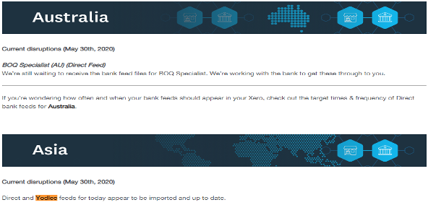

The BIG Metrics
Refresh Metrics tells the status of the refreshes and is used across as standard to check the performance. AND its directly related to Billing as well. For ex : US Locale has an average success rate of 95%. This is for approximately 4.5Lacs refreshes triggered per hour. Below is the snapshot of Xero cobrand which uses this metrics and shares update to their customers or show their health status.

Slide 6

Problem statement
The metrics is directly impacted by the Banks health. For example if National Bank of Australia is down due to scheduled maintenance activity or due to some technical issue, requests would start to fail for us as well.
Impact : It Causes the requests to fails impacting up to 20000 refreshes per hour which is a real bad customer experience.
Challenge : We cannot modify the refresh cycle (it would mean, changing with the core design) but we can stop triggering the refresh request for certain duration. This duration would be hereby called as “maintenance window” which is nothing but pausing the refresh cycle till the duration maintenance window is applied .

Slide 7

Use case & Approach
Use-Case : To be notified of the failures for sites without manually checking the stats or taking reactive measures post failures.
Solution :
Web Crawler We can run a continuous scheduler to go through the news feed of banks like there official twitter/ Facebook accounts and look for words like “maintenance”, ”troubleshoot”, ”inconvenience”, ”site down”.
Notification Once these keywords are found, fire alert/notification mails to the stakeholders and to apply the window to stop the refreshes.
Exposing Services for other products(created specifically to meet the Target case study exercise).

Slide 8

Project Details
Shared application is an independent standalone web application which uses the APIs exposed by Twitter to gather any information regarding banks health.
It’s a simple webapp maven project with below flow:
Cron Job scheduling the request to read the tweets for the tweeter handled mentioned in the “Twitter.properties” file.
The tweets of the handles are read using the twitter APIs.
Tweets are filtered based on the keywords mentioned in properties file.
If the text contains keywords like “maintenance activity” email notification is sent to the stakeholders for further action.
In Actual project it was also hitting a service to auto notify the internal organisation tool which then performs the auto pause of refresh.
For this project instead of that I have created a simple rest service to get user specific all tweets in text format or get all the tweets of all the users which return the response in JSON format.
Repository URL : https://github.com/yadavprerna19/WebCrawler_BankFeed

Slide 9

Thank You
Prerna Singh

